Slide 1
Micro-Credit Defaulter
Amritesh Kumar
Dec 2021

Slide 2

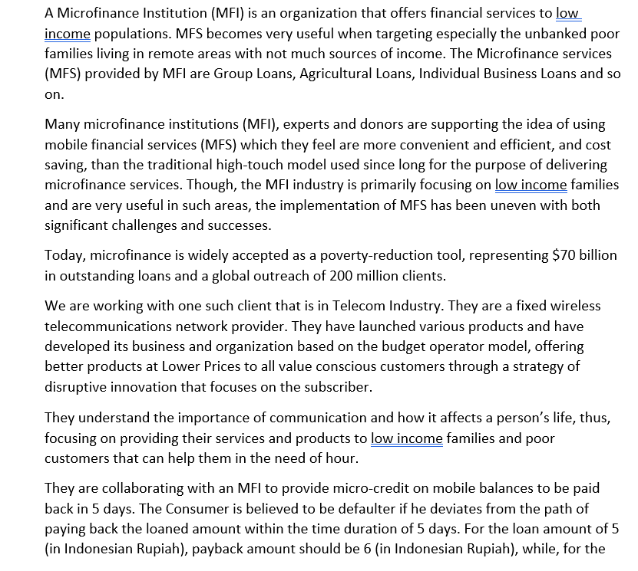
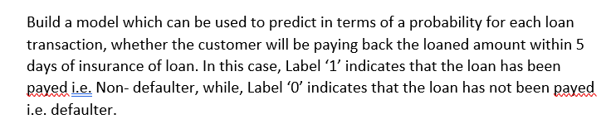
Problem Overview

Slide 3
Conceptual Background of the Domain Problem
MACHINE LEARNING AND DATA SCIENCE FOR BUSINESS:
Machine learning is a branch of artificial intelligence (AI) & computer science focusing on the use of data & algorithms to imitate the way that humans learn from experience, make predictions and gradually improving its accuracy. It is an important component of the growing field of data science.
Through the use of statistical methods, algorithms are trained to make classifications or predictions, uncovering key insights within data mining projects. These insights subsequently drive decision making within applications and businesses, ideally impacting key growth metrics.
As big data continues to expand and grow, the market demand for data science will increase, requires to assist in the identification of the most relevant business questions and subsequently the data to answer them. Following are the ways Data science can add value to Business :
• Empowering management and officers to make better decision
• Directing actions based on trends—which in turn help to define goals
• Challenging the staff to adopt best practices and focus on issues that matter
• Identifying opportunities
• Decision making with quantifiable, data-driven evidence
• Testing these decisions
• Identification and refining of target audiences

Slide 4
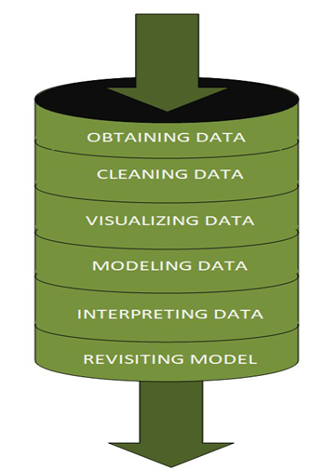
DATA SCIENCE PIPELINE:
The data science pipeline is a collection of connected tasks that aims at delivering an insightful data science product or service to the business organization.
The responsibilities include collecting, cleaning, exploring, modeling, interpreting the data, and other processes of the launching of the product.
“This final product can be used for to achieve Business Goals”
Exploratory Data Analysis (EDA) & IT’s TYPES:
The main purpose of EDA is to help look at data before making any assumptions.
It can help identify obvious errors, as well as better understand patterns within the data, detect outliers or anomalous events, find interesting relations among the variables.
Data scientists can use exploratory analysis to ensure the results they produce are valid and applicable to any desired business outcomes and goals.
EDA also helps stakeholders by confirming they are asking the right questions
TYPES OF EXPLORATORY DATA ANALYSIS:
Univariate Non-graphical
Multivariate Non-graphical
Univariate graphical
Multivariate graphical

Slide 5
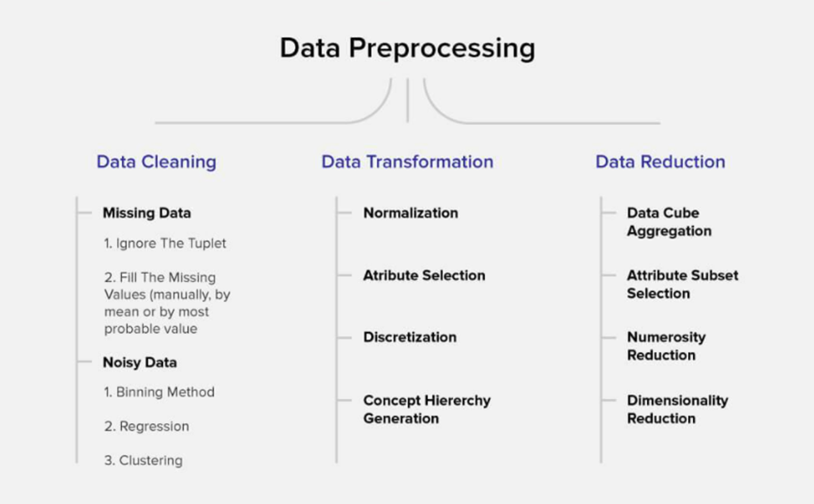
DATA PRE-PROCESSING
Data per-processing is a very vital input to machine learning models, It is to prepare the raw data & make it suitable for efficient machine learning model. These are the methods of data preprocessing and we are going to use the required ones in our project.

Slide 6
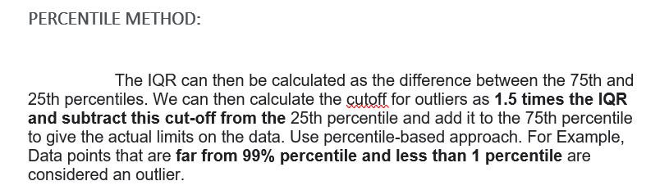
FEATURE ENGINEERING
Variance Inflation Factor (VIF)
Variance Inflation Factors (VIFs) measure the correlation among independent variables in least squares regression models. Statisticians refer to this type of correlation as multicollinearity. Excessive multicollinearity can cause problems for regression models. The stats models package has VIF library, Let us import the package.
SKEWNESS REMOVAL-(POWER-TRANSFORM):
Power transform will make the probability distribution of a variable more Gaussian.
This is often described as removing a skew in the distribution, although more generally is described as stabilizing the variance of the distribution. The power-transform library present in the Sklearn, Pre-processing package.
MINMAX SCALER:
MinMax Scaler shrinks the data within the given range, usually of 0 to 1. It scales the values to a specific value range without changing the shape of the original distribution. Before scaling we have to train test split the data, Since we have to do skewness removal and scaling only on input data.
TRAIN TEST SPLIT:
The scikit-learn Python machine learning library provides an implementation of the train-test split evaluation procedure via the train_test_split() function. The function takes a loaded dataset as input and returns the dataset split into two subsets. train_test_split() will split arrays data into random subsets. The ideal split is said to be 80:20 for training and testing.

Slide 7


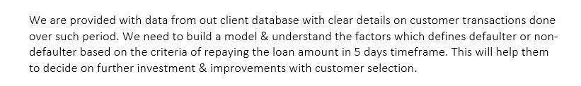
Review of Literature
ABSTRACT:

Slide 8
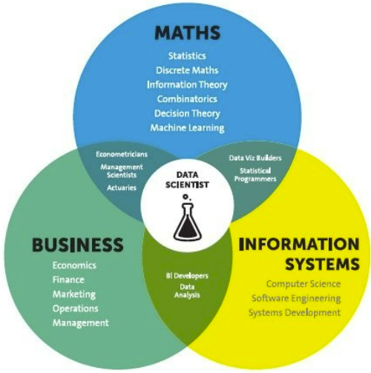
Analytical Problem Framing
Mathematical / Statistical / Analytical Modeling - are three of the most important concepts of Data Science. Data Science revolves around these three fields and draws their concepts to operate on the data.
Mathematical Modelling
Mathematical models are important, selecting the right one to answer the business question can bring tremendous value to the organization. It plays an essential role in the latest technologies like Machine Learning, Artificial Intelligence, Data Science and Deep Learning, etc., It is because every algorithm built in the latest technologies has a mathematical function behind it and aid in identifying patterns
The understanding of various notions of Statistics and Probability Theory are key for the implementation of such algorithms in data science.
Notions include: Regression, Maximum Likelihood Estimation, the understanding of distributions (Binomial, Bernoulli, Gaussian (Normal)) and Bayes’ Theorem
The main reason for a greater significance of mathematics is because of its various concepts like: –
Linear Algebra
Probability
Calculus – Differential & Integral Calculus
Statistics
Descriptive (Mean, Median, Mode, IQR, Std. deviation, Z & T- Statistics, linear regression)
Inferential (Sampling, Confidence interval, chi-square, ANOVA)

Slide 9
Analytical Problem Framing
Regression Models:
Data analysts use regression models to examine relationships between variables. Regression models are often used by organizations to determine which independent variables hold the most influence over dependent variables—information that can be leveraged to make essential business decisions
Classification Models:
Classification is a process in which an algorithm is used to analyze an existing data set of known points. The understanding achieved through that analysis is then leveraged as a means of appropriately classifying the data. Classification is a form of machine learning that can be particularly helpful in analyzing very large, complex sets of data to help make more accurate predictions.

Slide 10
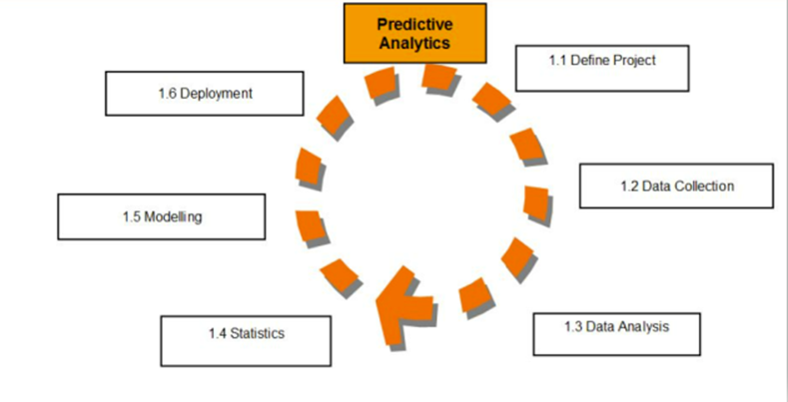
Analytical Models:
An analytical model is quantitative in nature, and used to answer a specific
question or make a specific design decision.
Different analytical models are used to address different aspects of the system,
such as its performance, reliability, or mass properties. Data analysis comes
with the fundamental types of data analytics encounter in data science: Descriptive, Diagnostic, Predictive, and Prescriptive.
Descriptive analytics is a statistical method that is used to search and summarize historical data in order to identify patterns or meaning.
Descriptive analysis is often used when reviewing any past or present data. This is because raw data is difficult to consume and interpret, while the metrics offered by descriptive analysis are much more focused.
The example of descriptive statistics or analytics is to calculate the mean, median mode, standard deviation, and similar kinds of statistical calculation on finance or sales data.
Diagnostic analytics takes it a step further to uncover the reasoning behind certain results. Diagnostic analytics is usually performed using such techniques as data discovery, drill-down, data mining, and different type of bivariant data analysis like correlations. etc.,
Predictive Analytics is a statistical method that utilizes algorithms and machine learning to identify trends in data and predict future behaviors. Predictive Analytics can take both past and current data and offer predictions of what could happen in the future.
Predictive models typically utilize variability in data to make the correct prediction and more variability of ingredient data that shows the relationship with what is possible to predict that united together into a prediction or valid score.
Prescriptive analytics automatically synthesizes big data, mathematical sciences, business rules, algorithms, and machine learning to make predictions and then suggests decision options to take advantage of the predictions. Prescriptive means (optimization and simulation).

Slide 11

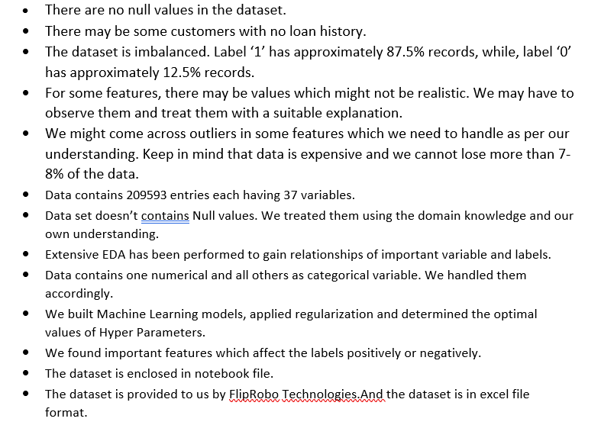
Data Sources and their formats

Slide 12
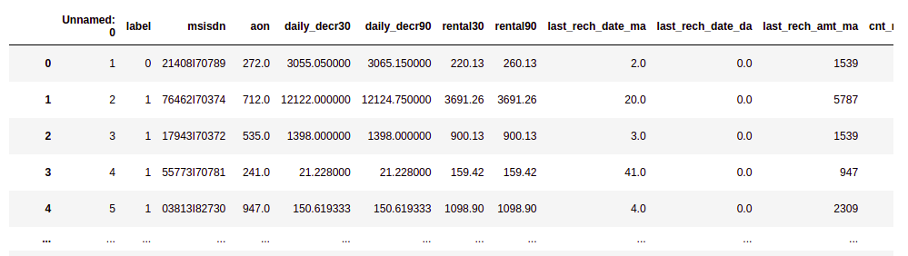
Data Description

Slide 13
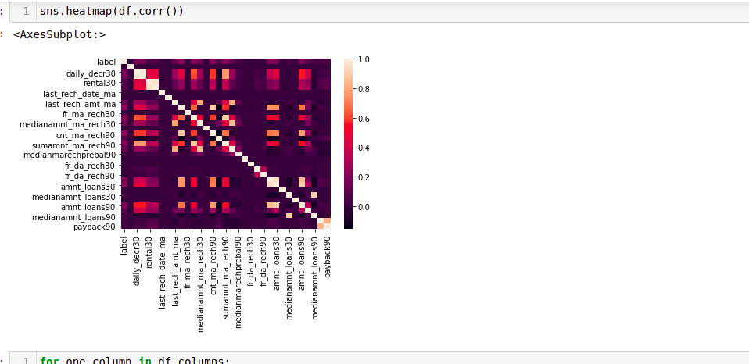
DATA ACQUISITION

Slide 14
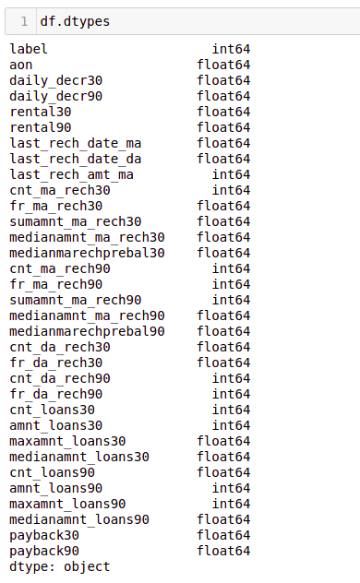
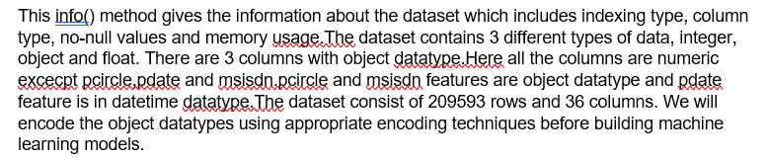
FEATURE DESCRIPTION:
Following are the features and their data type details,

Slide 15
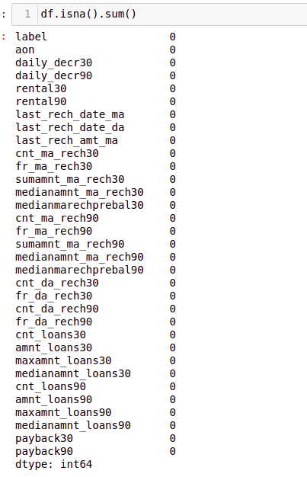

Slide 16
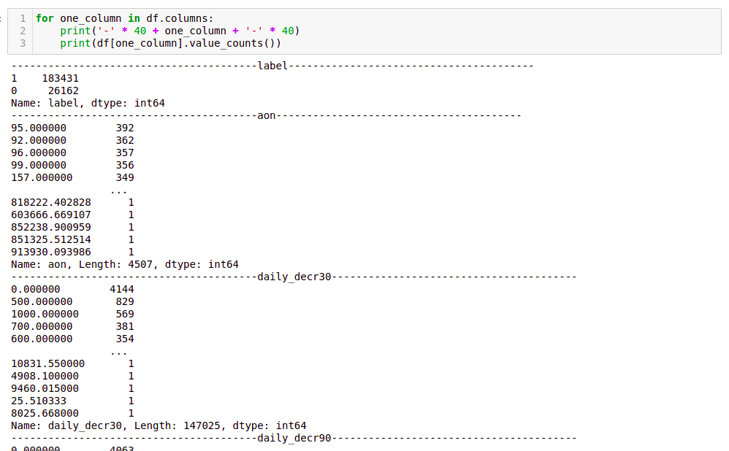
Data Analysis and Reprocessing

Slide 17
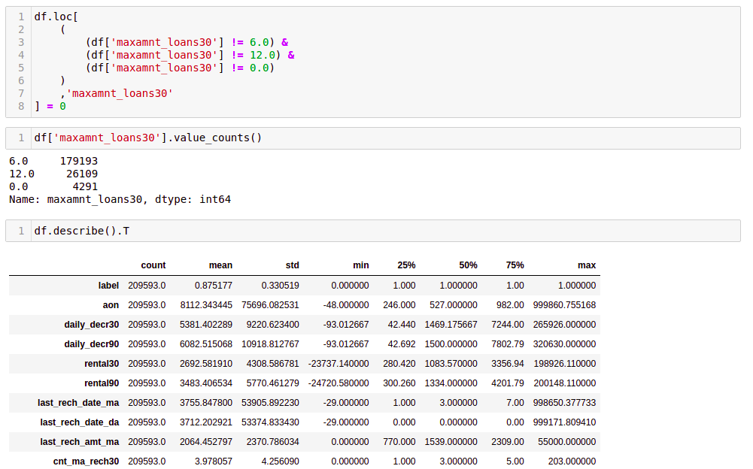
Data Analysis and Reprocessing

Slide 18
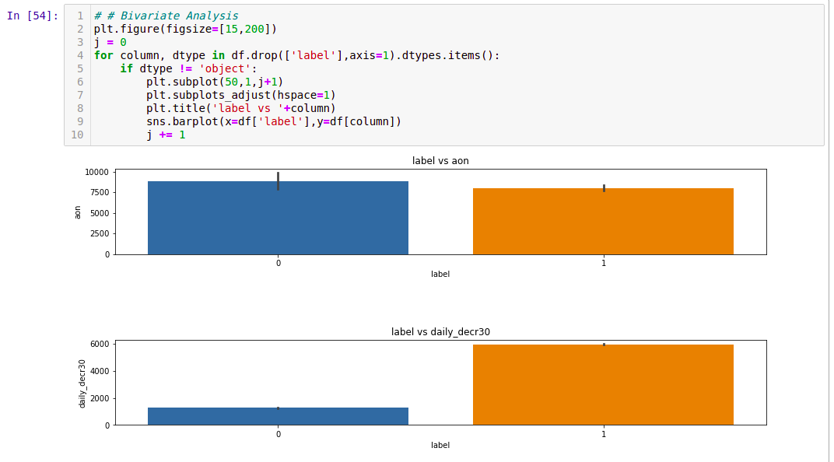
Data Analysis and Reprocessing

Slide 19
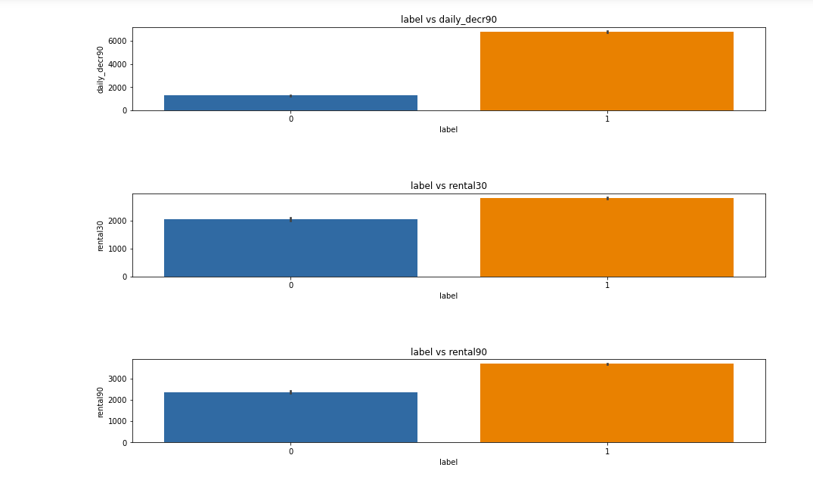

Slide 20
Data Inputs- Logic- Output Relationships
In Classification, the output variable must be a discrete value.
In classification, inputs are divided into two or more classes, and the learner must produce a model that assigns unseen inputs to one (or multi-label classification) or more of these classes. This is typically tackled in a supervised way.
In machine learning, classification refers to a predictive modeling problem where a class label is predicted for a given example of input data. A classification model attempts to draw some conclusion from observed values. Given one or more inputs a classification model will try to predict the value of one or more outcomes. The output variables are often called labels or categories.
A classification can have real-valued or discrete input variables. A problem with two classes is often called a two-class or binary classification problem. A problem with more than two classes is often called a multi-class classification problem. A classification algorithm, in general, is a function that weighs the input features so that the output separates one class into positive values and the other into negative values.
Classification is a data mining function that assigns items in a collection to target categories or classes. The goal of classification is to accurately predict the target class for each case in the data. For example, a classification model could be used to identify loan applicants as low, medium, or high credit risks.
Classification analysis is a data analysis task within data-mining, that identifies and assigns categories to a collection of data to allow for more accurate analysis.
Classification analysis can be used to question, make a decision, or predict behaviour through the use of an algorithm.

Slide 21
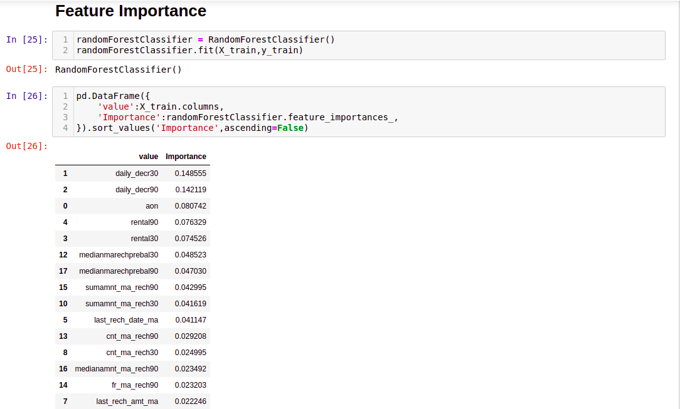
Data Pre-processing & Feature Engineering

Slide 22
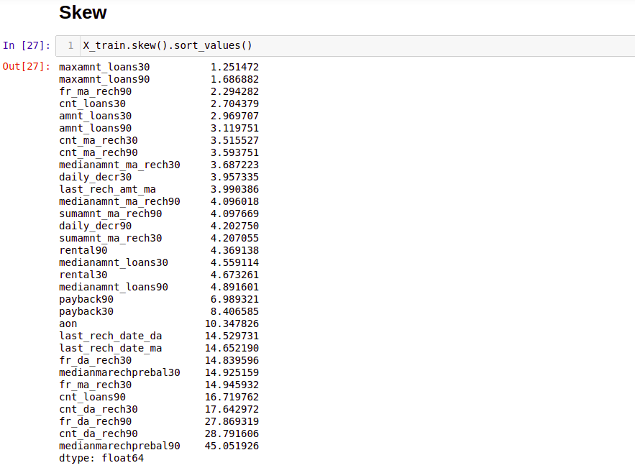

Slide 23
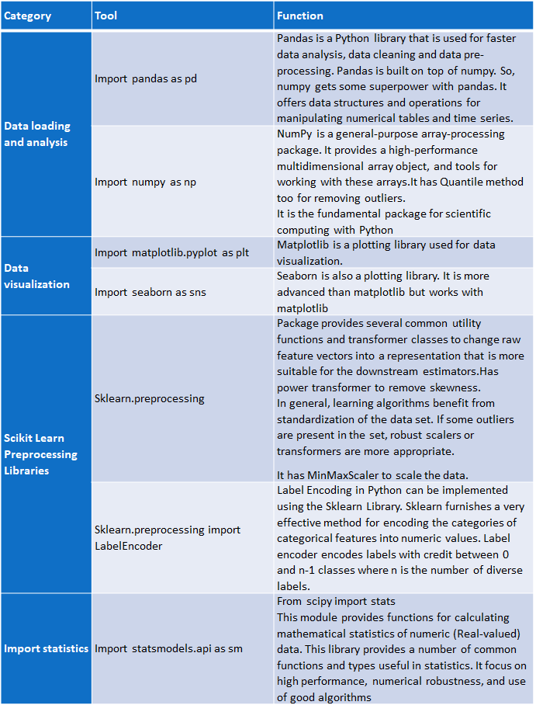
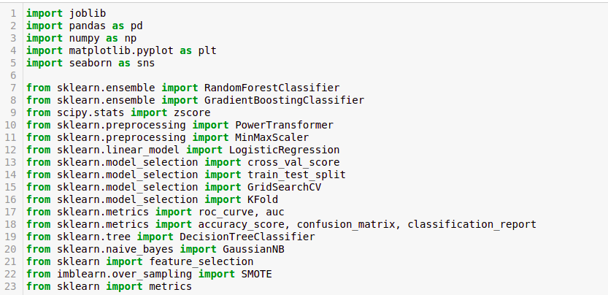
HARDWARE & SOFTWARE TOOLS, LIBRARIES & PACKAGES USED:
Hardware :Intel i7,RAM 16GB used.
Software: Jupyter Notebook (Anaconda 3)
Language: Python
Libraries:
Pandas
Numpy
Matplotlib
Seaborn
Sklean
Scipy
Statsmodels
Pip-Package install Manager

Slide 24
Variance Inflation Factors (VIFs)
Measure the correlation among independent variables in least squares regression models. Statisticians refer to this type of correlation as multicollinearity. Excessive multicollinearity can cause problems for regression models. The stats models package has VIF library and we can import this library.
The scikit-learn Python machine learning library provides an implementation of the train-test split evaluation procedure via the train_test_split() function. The function takes a loaded dataset as input and returns the dataset split into two subsets.train_test_split() will split arrays data into random subsets. The ideal split is said to be 80:20 for training and testing.
The most commonly used Performance metrics for classification problem are as follows,
• Accuracy.
• Confusion Matrix.
• Precision, Recall, and F1 score.
• ROC AUC.
• Log-loss.
Grid search is used as an approach to hyper-parameter tuning that will methodically build and evaluate a model for each combination of algorithm parameters specified in a grid. GridSearchCV helps us combine an estimator with a grid search preamble to tune hyper-parameters.
Cross-validation is a technique in which we train our model using the subset of the data-set and then evaluate using the complementary subset of the data-set.
The three steps involved in cross-validation are as follows :
1. Reserve some portion of sample data-set.
2. Using the rest data-set train the model.
3. Test the model using the reserve portion of the data-set.
The most important use of PCA is to represent a multivariate data table as smaller set of variables (summary indices) in order to observe trends, jumps, clusters and outliers. This overview may uncover the relationships between observations and variables, and among the variables.
Also import all the required algorithms for classification purpose below

Slide 25
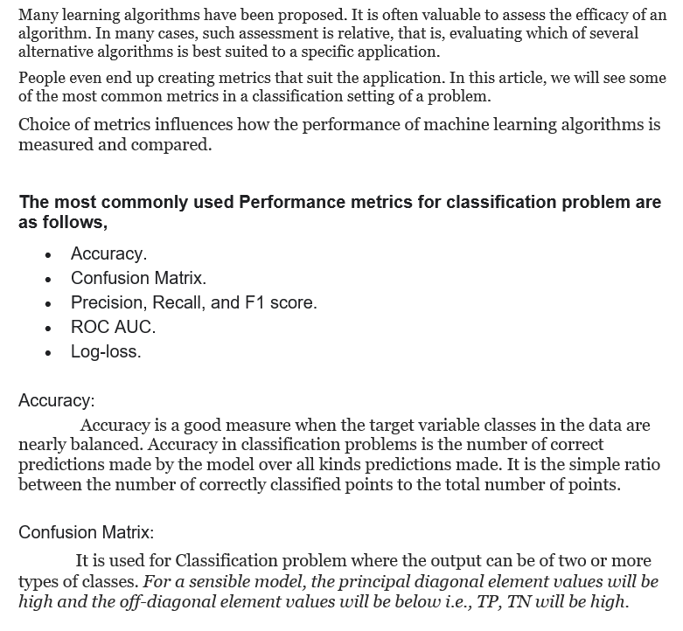
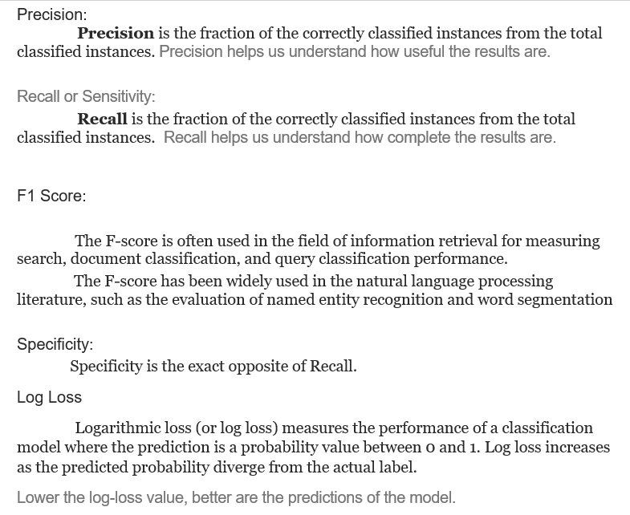
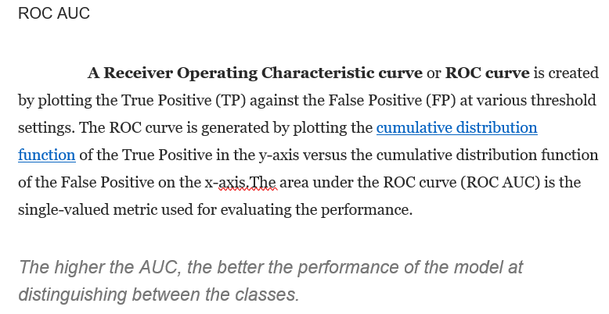

Slide 26
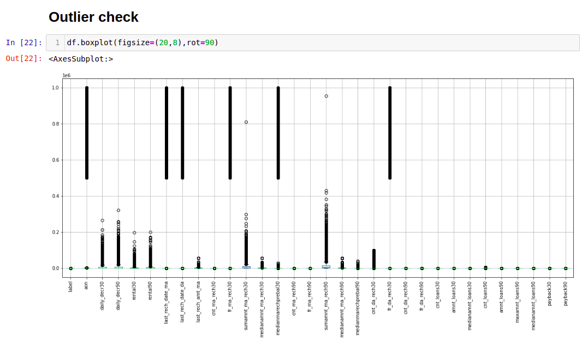
Model/s Development and Evaluation
Identification of possible problem-solving approaches (methods)

Slide 27
Testing of Identified Approaches (Algorithms)
These are all the Algorithms used for Model Building and Prediction.We did Hyper Parameter Tuning with these algorithms using the GridSearchCV.
RandomForestClassifier
GaussianNB
KNeighborsClassifier
AdaBoost Classifier
SVC(Support Vector Classifier)
LogisticRegression
Soft Voting Classifier
Hard Voting classifier
DecisionTreeClassifier
Gradient Boosting Classifier
LightGradientBoostingClassifier
CatBoostClassifier
ExtraTreesClassifier
XGBoost Classifier
These algorithms has been used for both Training and Testing purpose and got evaluated with classification metrics such as f1score,confusion matrix, precision, recall and AUC ROC curve etc.,

Slide 28
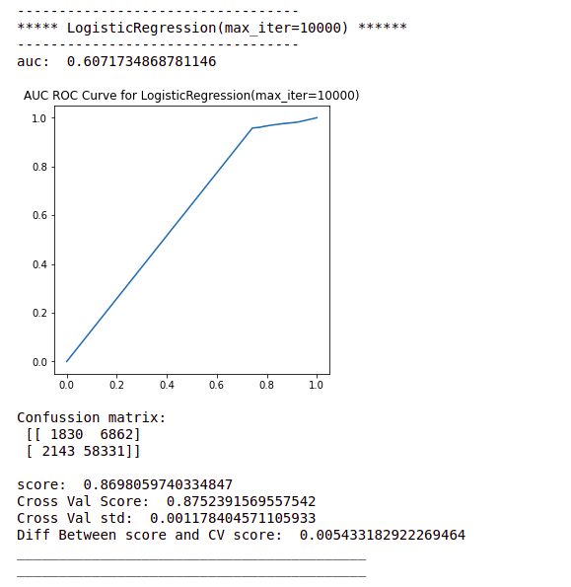
Run and Evaluate selected models
Logistic Regression:
Logistic regression is used to describe data and to explain the relationship between one dependent binary variable and one or more nominal, ordinal, interval or ratio-level independent variables. Logistic regression is a simple and more efficient method for binary and linear classification problems. It is a classification model, which is very easy to realize and achieves very good performance with linearly separable classes. It is an extensively employed algorithm for classification. Logistic Regression is used when the dependent variable(target) is categorical.

Slide 29
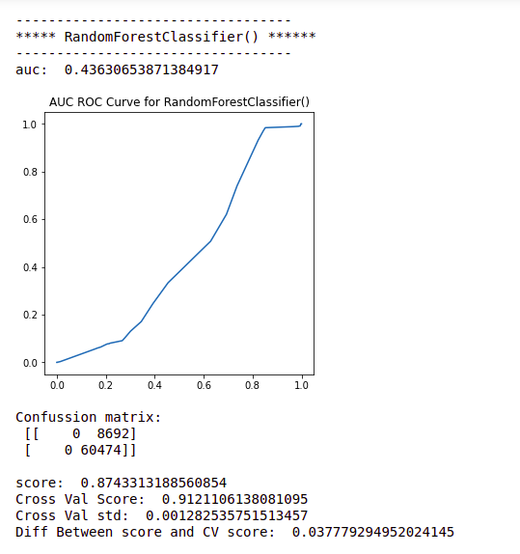
RANDOM FOREST REGRESSION:
Random forest is a classification algorithm consisting of many decisions trees. It uses bagging and feature randomness when building each individual tree to try to create an uncorrelated forest of trees whose prediction by committee is more accurate than that of any individual tree. It can perform both regression and classification tasks. A random forest produces good predictions that can be understood easily. It can handle large data sets efficiently. The random forest algorithm provides a higher level of accuracy in predicting outcomes over the decision tree algorithm.
Random forest adds additional randomness to the model, while growing the trees. Instead of searching for the most important feature while splitting a node, it searches for the best feature among a random subset of features. This results in a wide diversity that generally results in a better model.

Slide 30
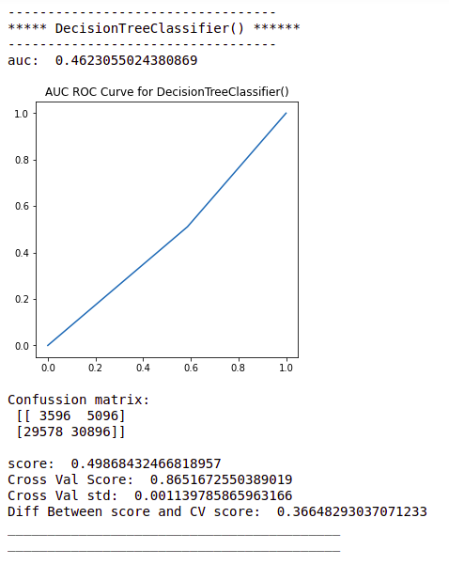
DECISION TREE CLASSIFIER:
The main advantage of the decision tree classifier is its ability to using different feature subsets and decision rules at different stages of classification. Decision tree often involves higher time to train the model. Decision tree training is relatively expensive as the complexity and time has taken are more. The Decision Tree algorithm is inadequate for applying regression and predicting continuous values. In this, the data is continuously split according to a certain parameter. The tree can be explained by two entities, namely decision nodes and leaves.

Slide 31
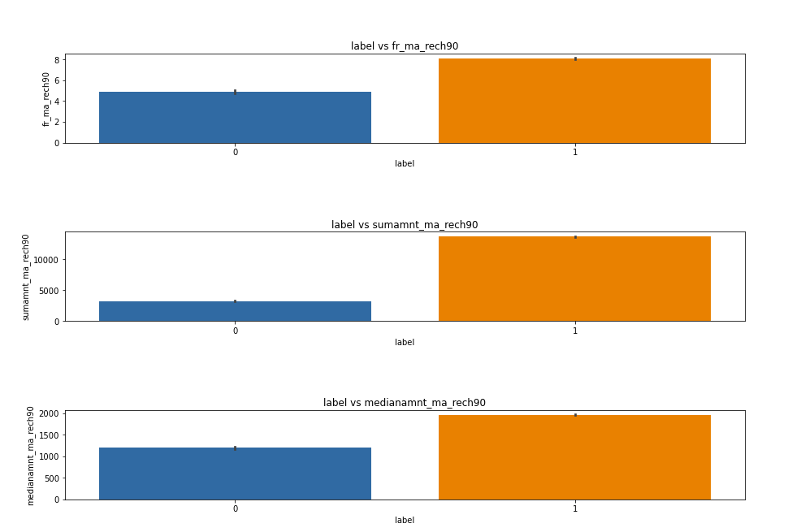

Slide 32
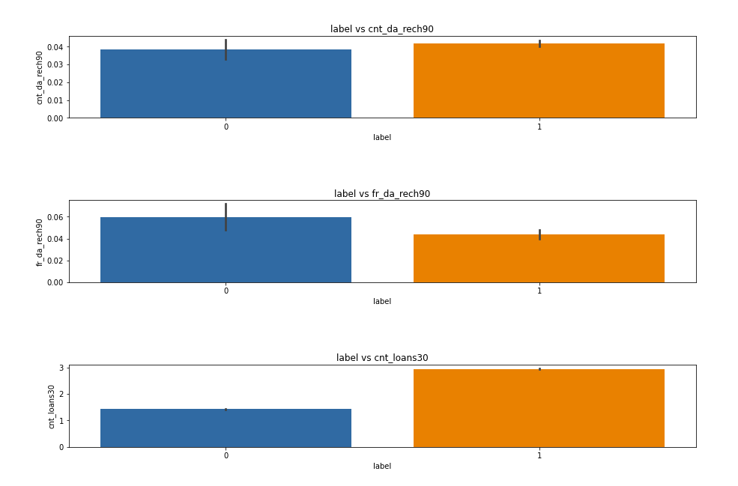

Slide 33
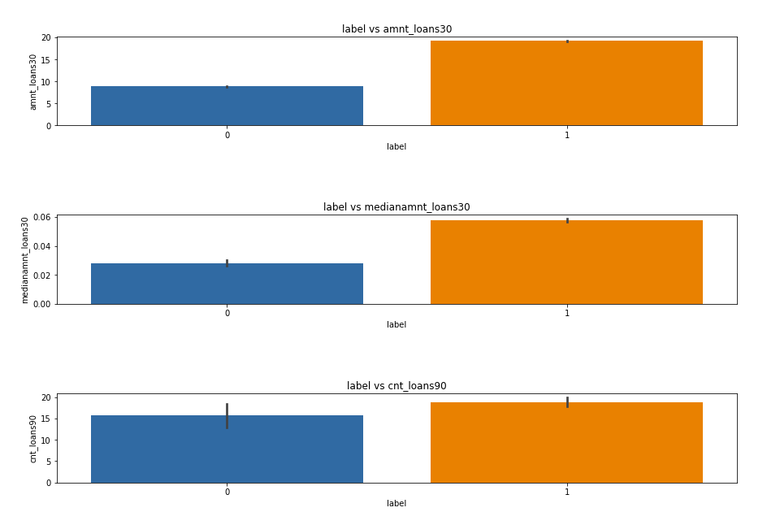

Slide 34
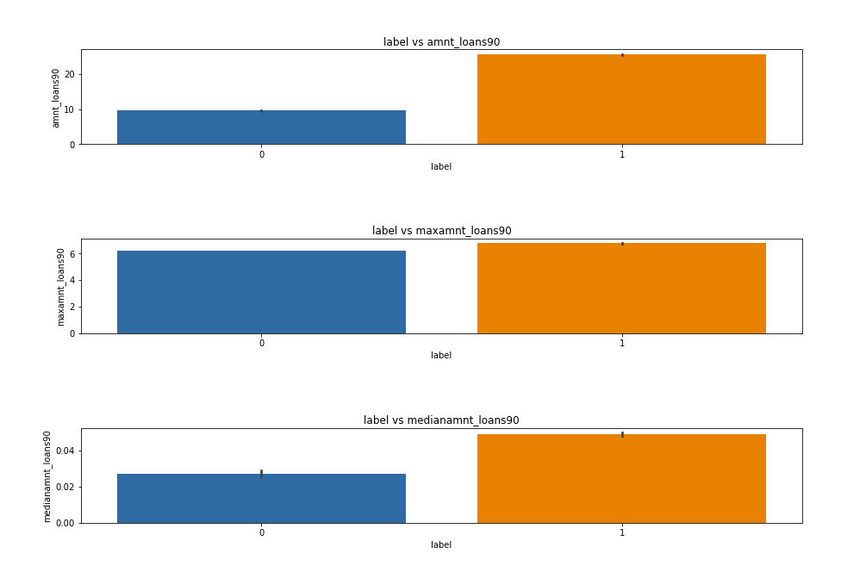

Slide 35
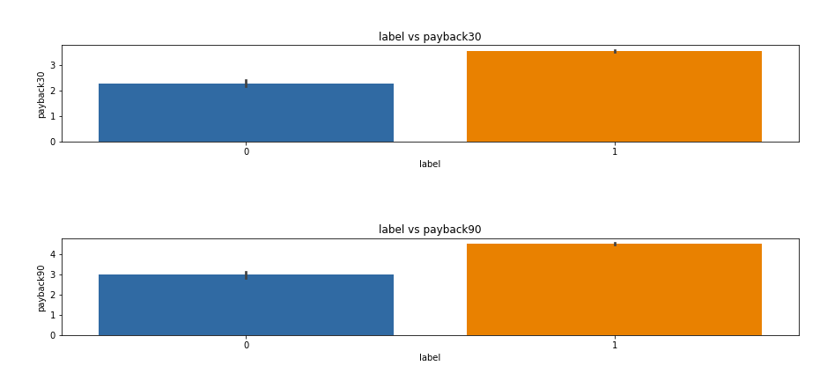

Slide 36

MODEL SAVING:

Slide 37
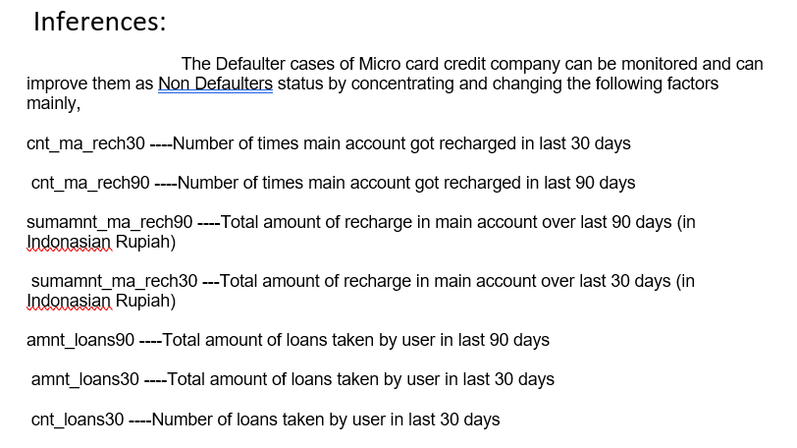
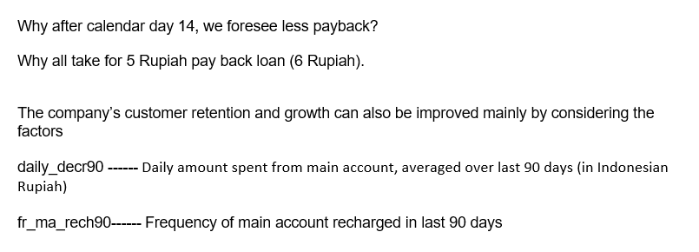
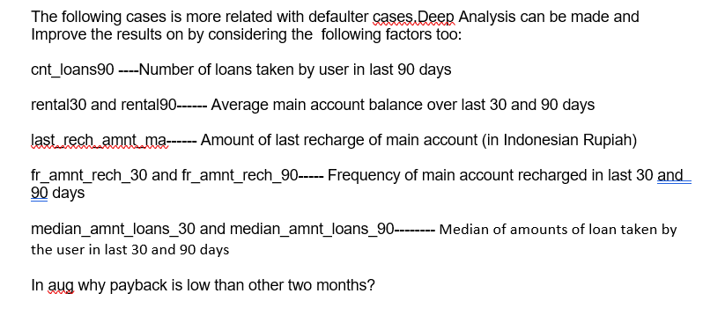

Slide 38
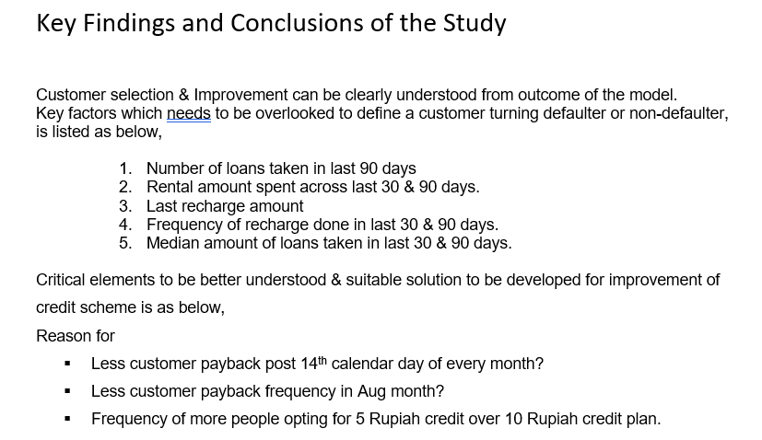
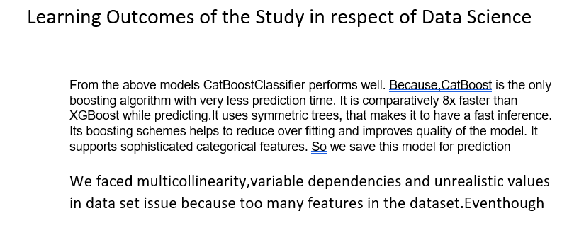

Slide 39
Thanks

